Slide 1
Deep Learning for
Depression Detection of Twitter Users
Student:
Tanookh Kabishi

Slide 2
The problem
Mental illness
Suicide
Complex
Problem statement
20% of Canadians experience mental illness and 8% of adults have gone through major depression.
Nearly 4,000 Canadians have died from suicide and 90% of them were identified as having some form of a mental disorder.
The detection of mental illness in social media, that reflects people’s life, is complex and it is continuously increasing in popularity on social media platforms

Slide 3
Solution
Supervised machine learning is not widely accepted because of the difficulties in obtaining sufficient amounts of annotated training data. The most effective deep neural networks architectures are identified and used to detect users with signs of mental illness given limited instructed text data.
Deep Neural Networks

Slide 4
Challenges
Challenge 1
Challenge 2
Challenge 3
Data importing and dividing.
The first challenge for us was importing the data and dividing it to train, test and validation.
Building the Neural Networks models
Building 4 different models:
CNN With Max
Multi Channel CNN
Multi Channel Pooling CNN
Bidirectional LSTM with attention
Understanding the results
After building the models and activating them, we take the results and understand it.

Slide 5
Implementation

Slide 6
Dealing with the data
Importing the data
Data
processing
Cleaning the
data
Splitting and a.formatting the data

Slide 7
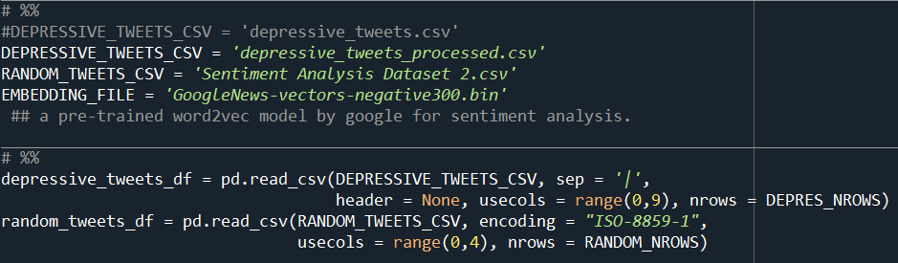

Slide 8
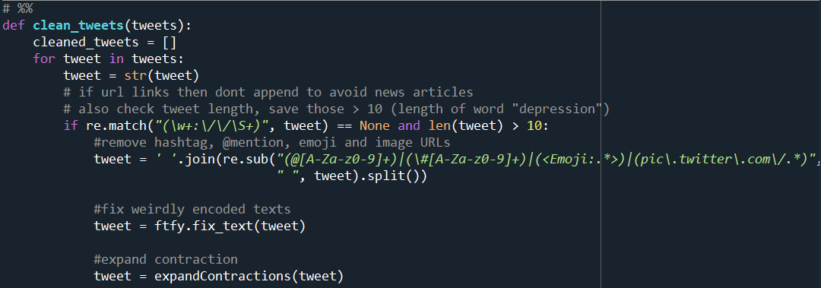

Slide 9
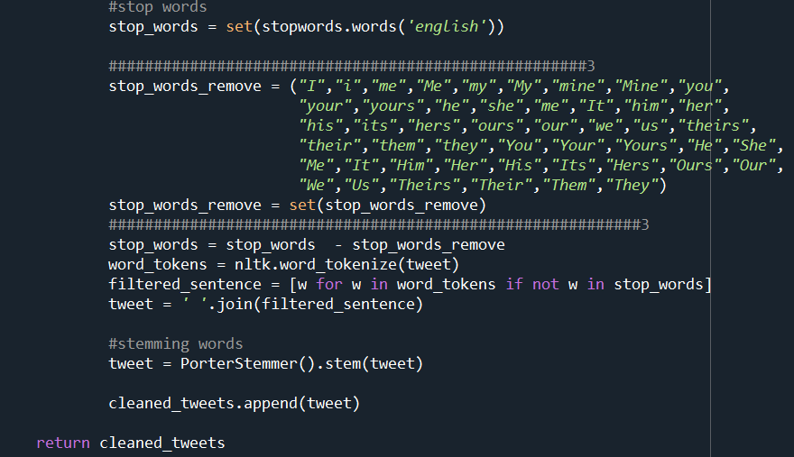

Slide 10
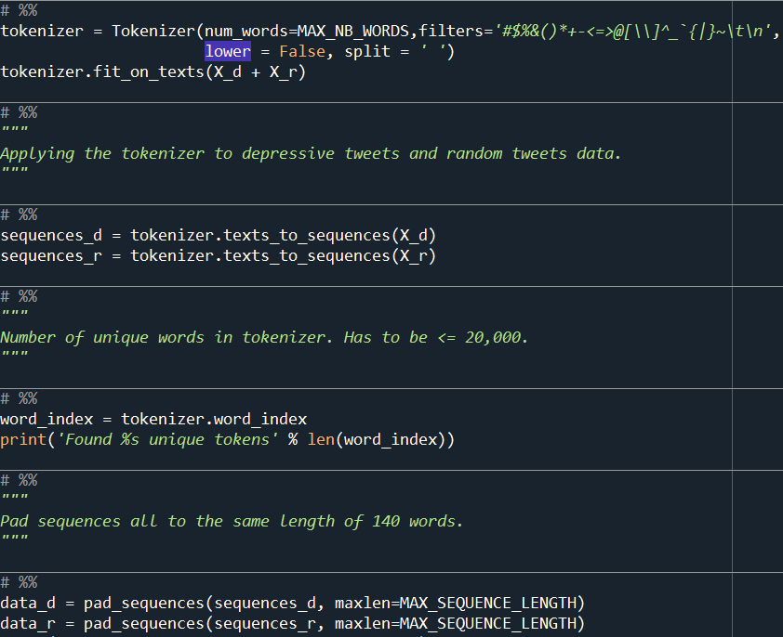

Slide 11
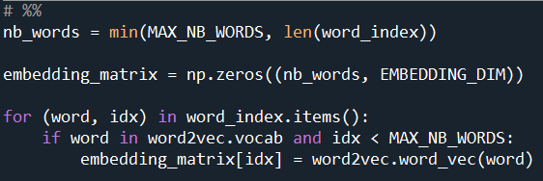

Slide 12
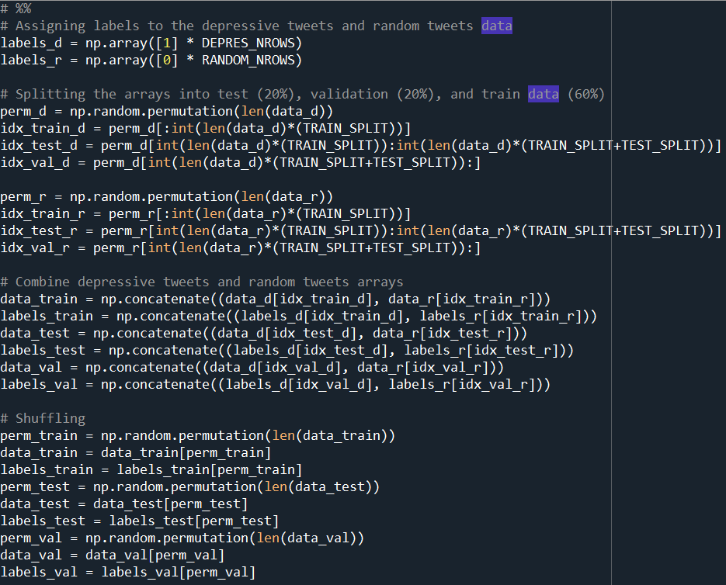

Slide 13
Building the Neural Networks models
CNN with Global Max
Multi Channel CNN
Multi Channel
Pooling CNN
Bidirectional
LSTM with
attention

Slide 14
Convolutional neural network
CNN can be changed to be one-dimensional, allowing it to develop an internal representation of a one-dimensional sequence.
This allows the CNN to be used more generally on other types of data that has a spatial relationship. For example, there is an order relationship between words in a document of text. There is an ordered relationship in the time steps of a time series.

Slide 15
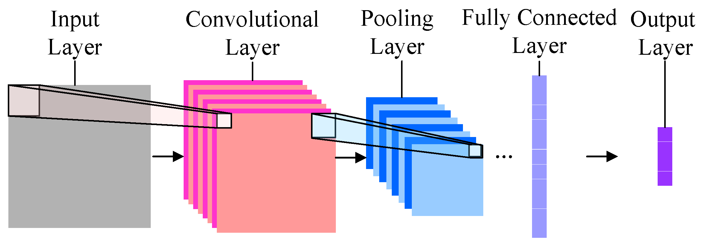

Slide 16
Input Layer
This is the first layer in the model and it represents each tweet as a row of vectors. Each vector represents a token based on the the sentiment analysis used. Each different word in a tweet has a different token to be embedded and will be represented into a specific vector with a fixed size of 140.
This layer is a matrix of size n×m, where m is the dimension of the embedding and n is (the min (between the number of unique words in our tokenizer and the max we specified)).

Slide 17
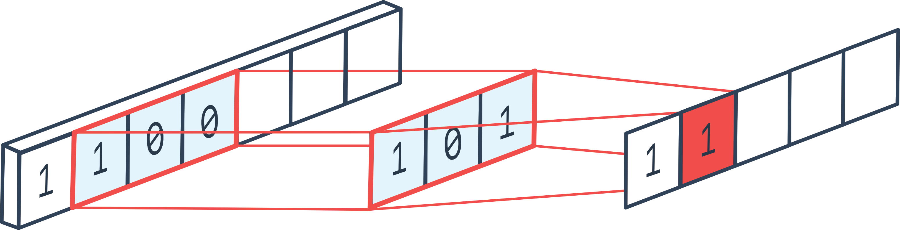
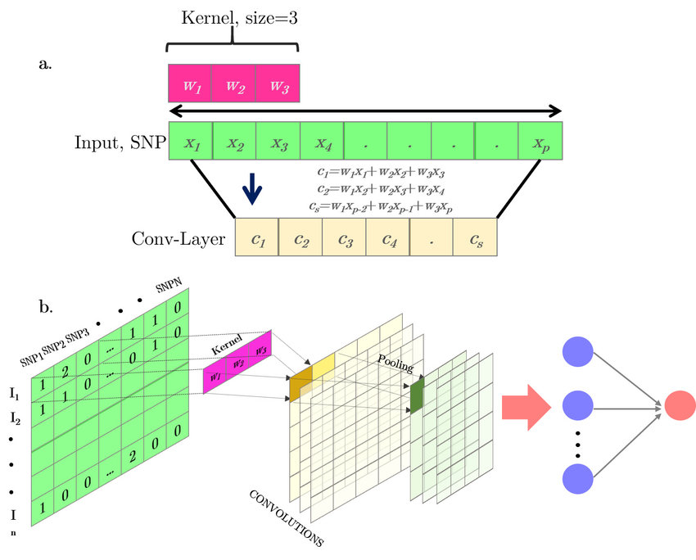
Convolutional Layer
Convolutional layers are the major building blocks used in convolutional neural networks. A convolution is the simple application of a filter to an input that results in an activation. Repeated application of the same filter to an input results in a map of activations called a feature map, indicating the locations and strength of a detected feature in an input.
In our project we used filter size of 250 and kernel size of 3 with ReLU activation.

Slide 18
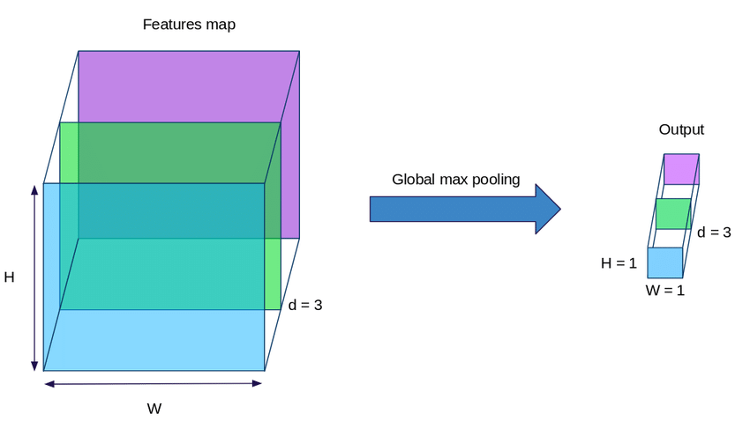
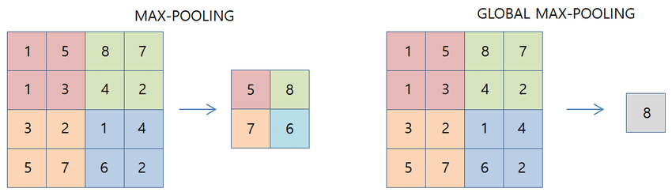
Global Max Pooling Layer
Is an ordinary max pooling layer with pool size equals to the size of the input (minus filter size + 1, to be precise). MaxPooling1D takes a pool_length argument, whereas GlobalMaxPooling1D does not.

Slide 19
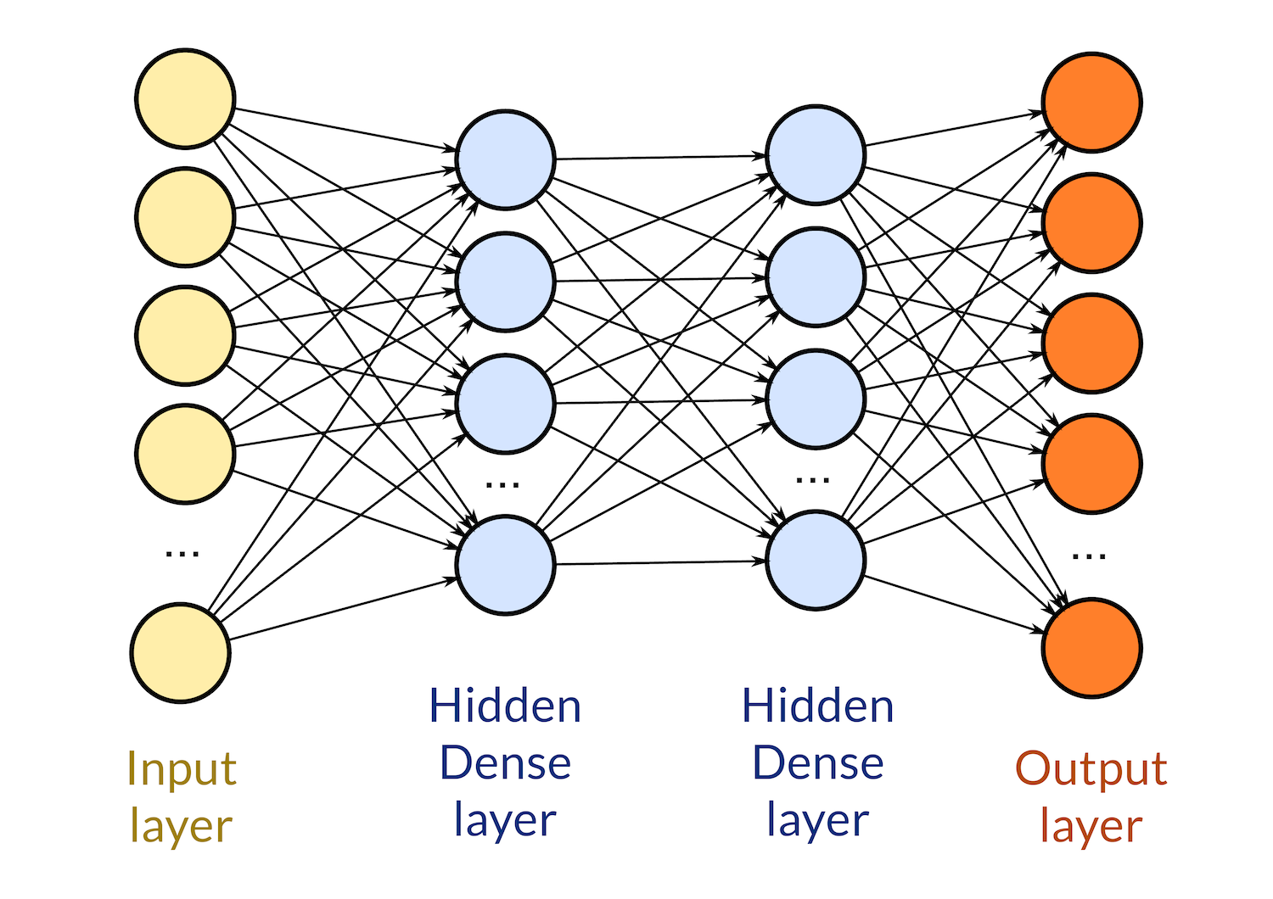
Dense Layer
Each neuron in a layer receives an input from all the neurons present in the previous layer — thus, they're densely connected. In other words, the dense layer is a fully connected layer, meaning all the neurons in a layer are connected to those in the next layer.
In our project we used a dense layer with 250 units using ReLU activation and then a dense layer with 1 unit (output) with sigmoid activation.

Slide 20
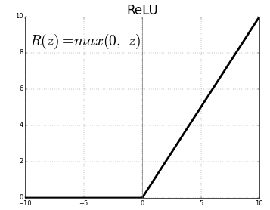
ReLU Activation Function
The rectified linear activation function or ReLU for short is a piecewise linear function that will output the input directly if it is positive, otherwise, it will output zero. A model that uses it is easier to train and often achieves better performance.
ReLU is computed after the convolution. The rectified linear activation function overcomes the vanishing gradient problem, allowing models to learn faster and perform better. ReLU improve neural networks by speeding up training.

Slide 21
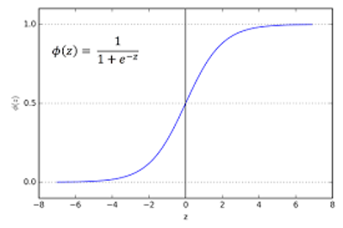
Sigmoid Activation Function
A sigmoid unit is a type of threshold unit that has a smooth threshold function, rather than a step function. The output of a sigmoid unit is in the interval (0,1).

Slide 22
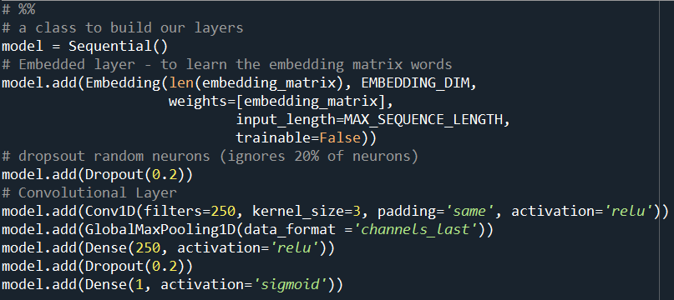
CNN with Global Max

Slide 23
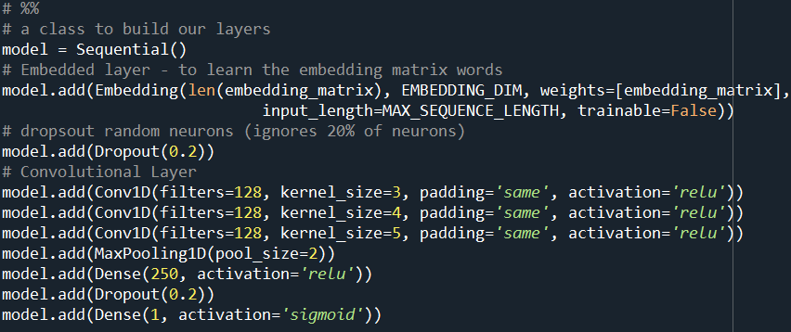
Multi Channel CNN

Slide 24
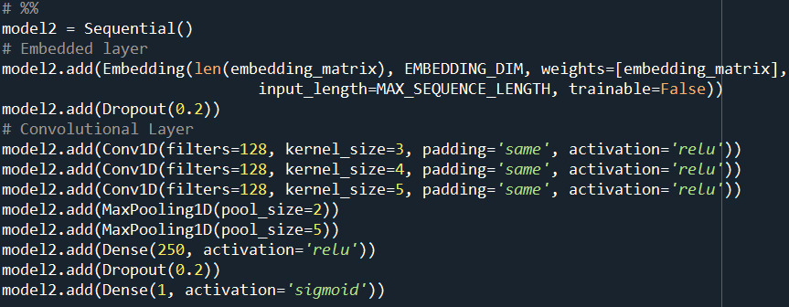
Multi Channel Pooling CNN

Slide 25
Recurrent neural network
Recurrent Neural Networks were designed to work with sequence prediction problems. Sequence prediction problems come in many forms and are best described by the types of inputs and outputs supported.
The Long Short-Term Memory, or LSTM, network is perhaps the most successful RNN because it overcomes the problems of training a recurrent network and in turn has been used on a wide range of applications.
RNNs in general and LSTMs in particular have received the most success when working with sequences of words and paragraphs, generally called natural language processing.

Slide 26
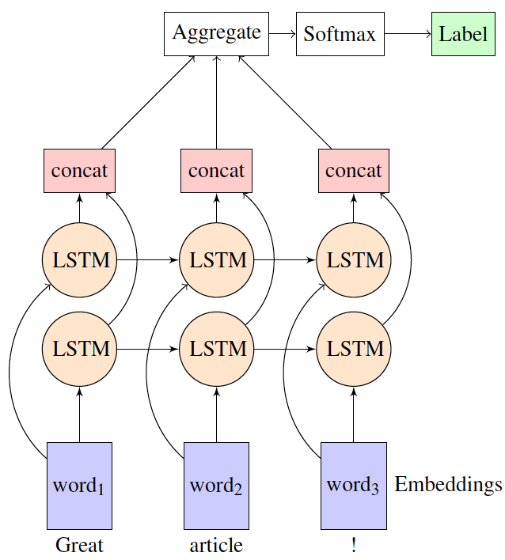
Bidirectional LSTM Layer
It involves duplicating the first recurrent layer in the network so that there are now two layers side-by-side, then providing the input sequence as-is as input to the first layer and providing a reversed copy of the input sequence to the second.
One of the advantages of the LSTMs is the ability of capturing the sequential data by considering the previous data. This layer takes the output vectors from the dropout layer as inputs. This layer has a set number of units or cells and the input of each cell is the output from the dropout layer. The final output of this layer have the same number of units in the network

Slide 27
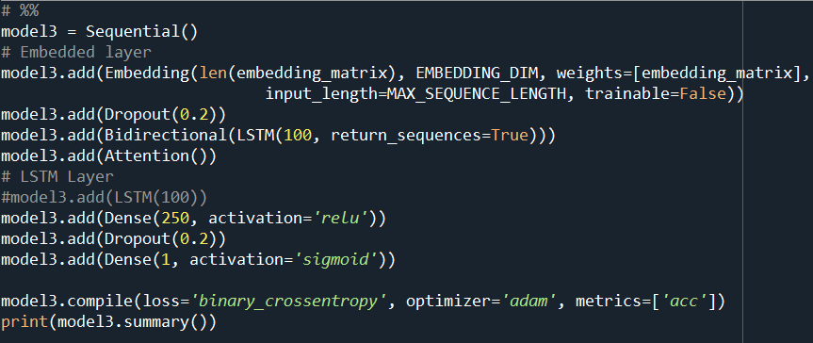
LSTM RNN

Slide 28
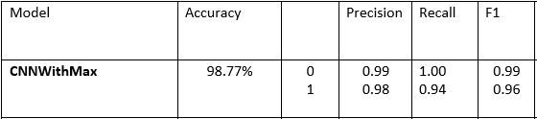
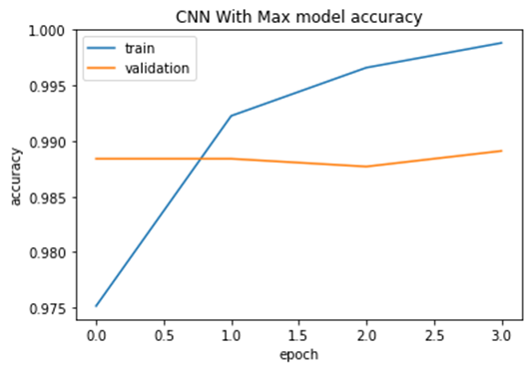
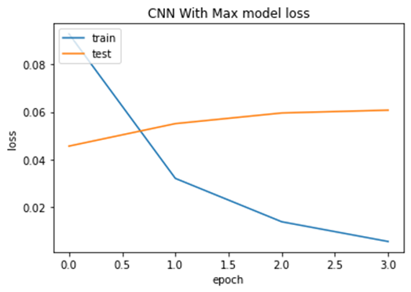
Results

Slide 29
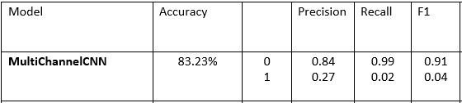
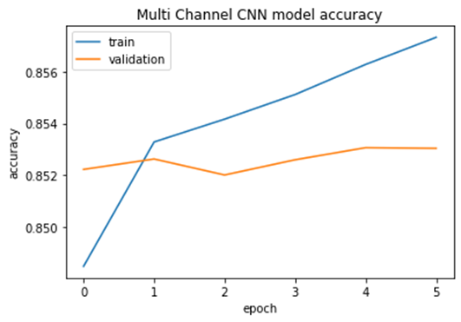
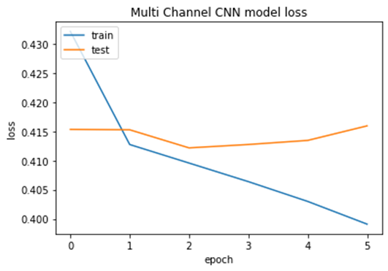
Results

Slide 30
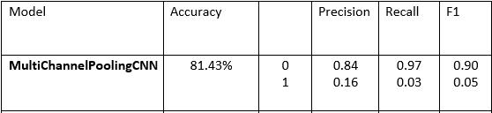
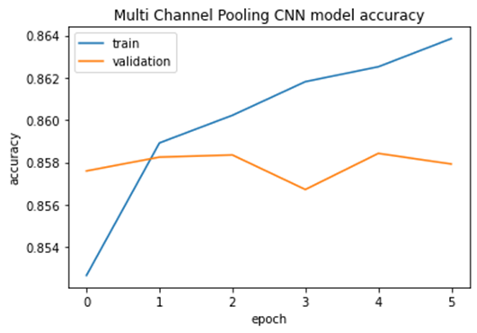
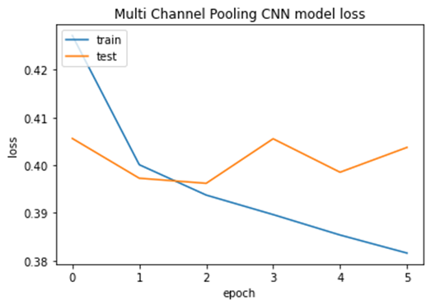
Results

Slide 31
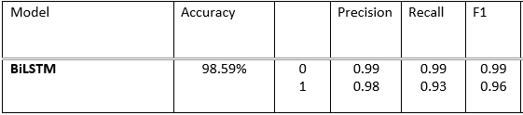
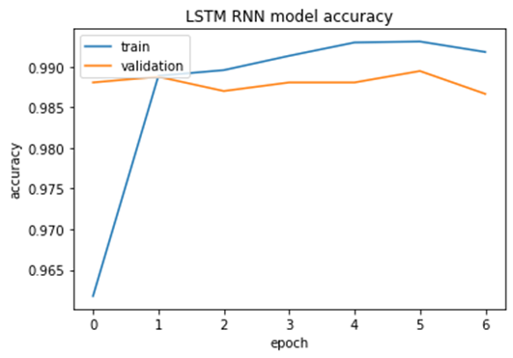
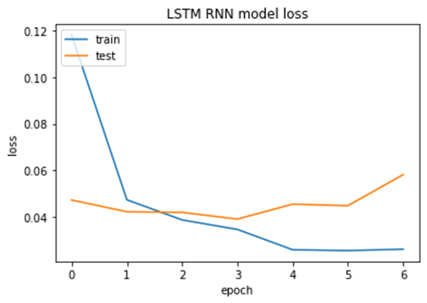
Results

Slide 32
Conclusion
In conclusion, we performed a comparative evaluation on 4 different deep learning models for depression detection from tweets on the user level. We performed the experiments on Kaggle’s dataset twitter_sentiment and using the Twitter scraping tool TWINT using the keyword depression by scraping all tweets in a one day span. The experiments showed that using CNN with Max model got us the best results followed by RNN with Bidirectional LSTM model.
Deep Neural Networks

